Slide 1
Tsinghua University Economic History and Development in Latin America Instructor: Prof. Lucas Llach (affiliation: Universidad Torcuato Di Tella, Argentina) Lecture 7/8. The Great Instability in Latin America (1970-1999)

Slide 2
Roadmap
The crisis of ISI and reform from within
The debt crisis & the burst of inflation
Stabilization and the embrace of globalization

Slide 3
Limit 1: "foreign exchange bottlenecks" & stagnations
"Easy stage" of industrialization (textiles, simple metalworking)
"Difficult stage": technology + capital intensive + big scale (petrochemical, steel)
Normally capital intensive industries required capital goods imports; and all manufacturing required imported inputs, but...
...exports were stagnant because of anti-export bias
Welcome to the STOP AND GO...

Slide 4
Limit 1: "foreign exchange bottlenecks" & stagnations
The answer of desarrollismo (late 1950s/1960s)
Welcome to foreign capital for investment, esp in inputs (eg., oil)
Don't be too harsh on traditional exports
Frondizi (Argentina), Kubitschek (Brazil).
OIL + MEAT = STEELMAKING + PETROCHEMICALS

Slide 5
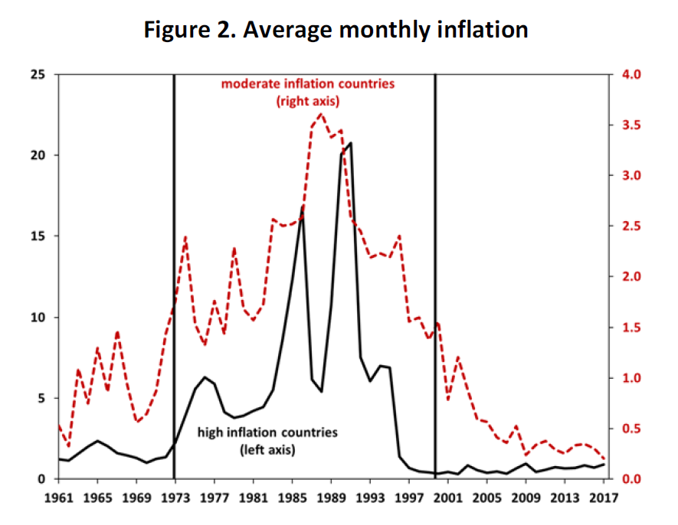
Limit 2: high inflation
Source: Keohe, Nicolini & Sargent

Slide 6
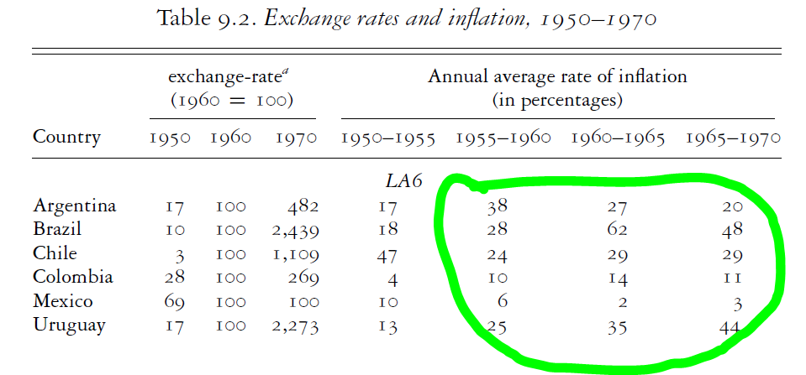
Limit 2: high inflation
Source: B. Thomas (2005)

Slide 7

Limit 2: high inflation Causes
MONETARIST
Persistent inflation is just the result of persistent fiscal deficits and their "monetization" (inflation tax)
Solution requieres budget equilibrium & orthodox monetary policy
STRUCTURALIST
"Elasticity" problems. Economies very dependent on imports (devaluation) and with low elasticity of export & food production.
Solution requieres solving those real bottlenecks.
Source: Keohe, Nicolini & Sargent

Slide 8
Reform from within?
The "New Strategies"
Export promotion: manufacturing with comparative advantages
"Export substitution" or trade openness
Back to priary specialization (especially smaller countries)

Slide 9
The Siren Song of Finance
International context: the oil crisis and the oil dollars
Abundance of financing as an anti-inflationary weapon
The "tablita" crises
The debt crisis and hangover

Slide 10
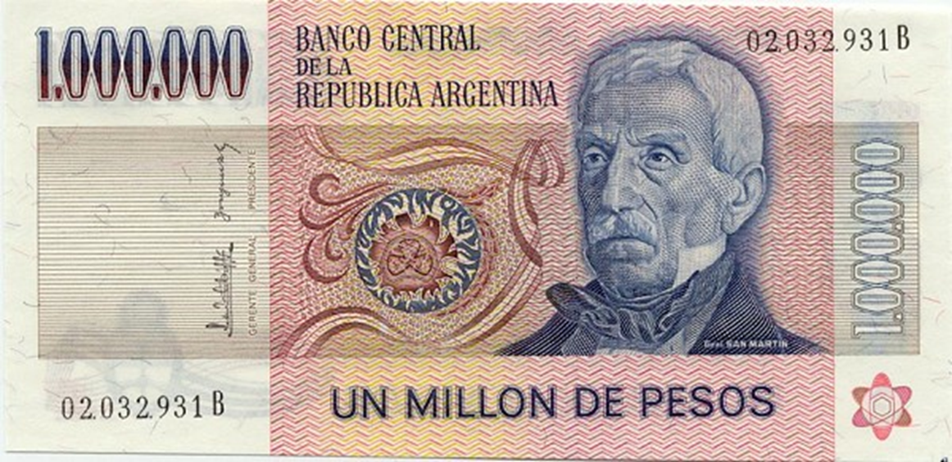
From high inflation to hyperinflation
Fiscal crisis --> money printing --> inflation
Currency devaluations due to external inbalances --> inflation
"Inflation feed inflation": Cagan effect & Olivera-Tanzi effect

Slide 11
The Challenges of Stabilization
"Heterodox stabilizations" (1980s)
Austral (Argentina)
Cruzado (Brazil)
Stabilization + reforms (1990s)
Convertibility (Argentina)
Plan Real (Brazil)

Slide 12
Reform: costs and benefits
Washington Consensus?
The policies of reform
Debt relief (Brady)
Trade openness, including regional agreements
Privatization
Better fiscal management

Slide 13
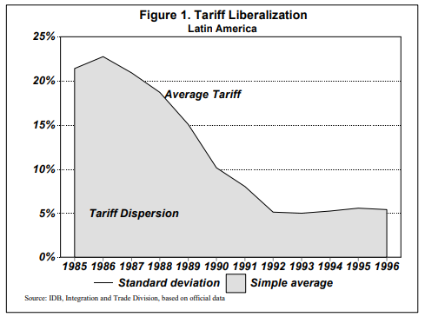
Reform: costs and benefits

Slide 14
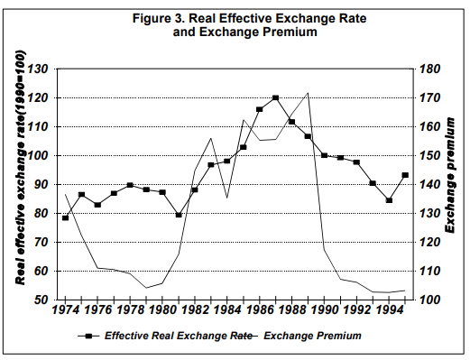
Reform: costs and benefits

Slide 15
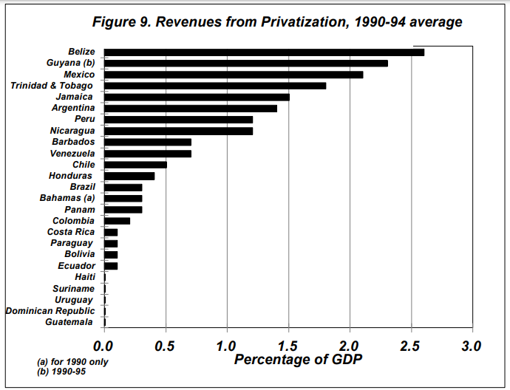
Reform: costs and benefits

Slide 16
The late 1990s crises
Before and after the Asian (1997) and Russian (1998) crises,
The Tequila effect
The crisis of the real
Argentina's 2001

Slide 17
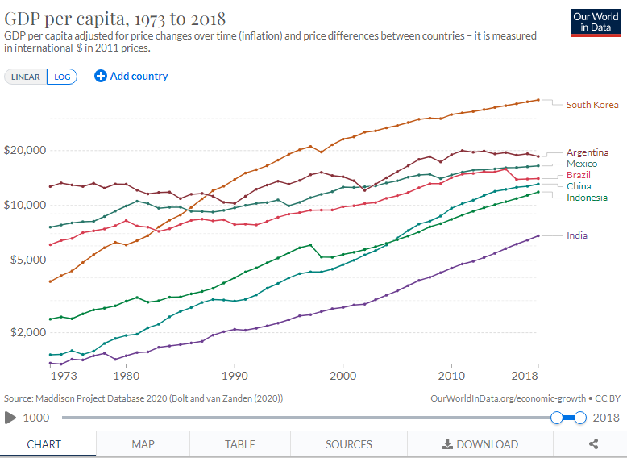
Not in my lifetime, so far…

Slide 18
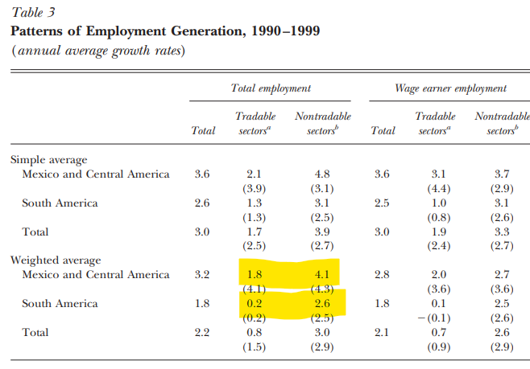
The (continued) rise of the non-tradable economy

Slide 19
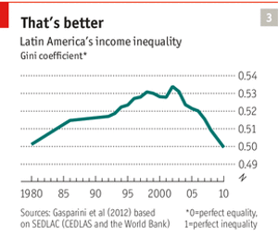
The (continued) rise of the non-tradable economy

